Slide 1
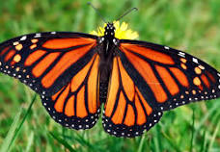
MAYORS MONARCH PLEDGE
Sponsored by The National Wildlife Federation

Slide 2
Mayors' Monarch Pledge Mayors and other heads of local and tribal government are taking action to help save the monarch butterfly, an iconic species whose eastern populations have declined by 90% and western populations by 99% in recent years. Through the National Wildlife Federation's Mayors' Monarch Pledge, U.S. cities, municipalities, and other communities are committing to create habitat for the monarch butterfly and pollinators, and to educate residents about how they can make a difference at home and in their community.

Slide 3
Commitments Mayors and heads of local or tribal government who have taken the Mayors’ Monarch Pledge must commit to implement at least three of the 30 following action items within a year of taking the pledge. At least one action must be taken from the “Program & Demonstration Gardens” section. Mayors that complete eight or more actions will receive special recognition as part of the National Wildlife Federation’s Mayors’ Monarch Pledge Leadership Circle Mayors that complete 24 or more actions will be recognized as a Monarch Champion.

Slide 4
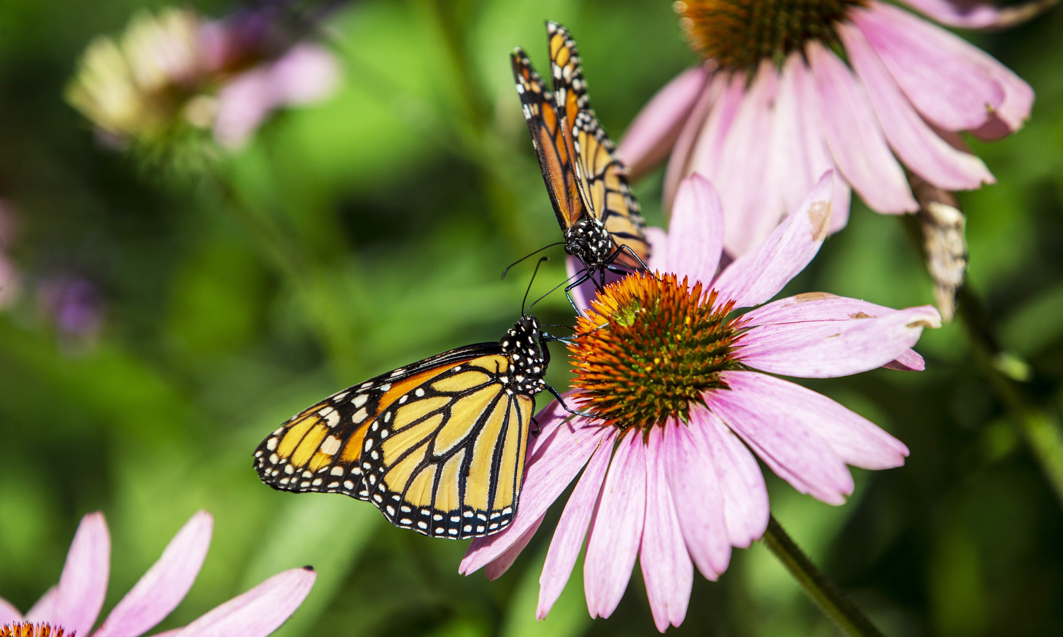
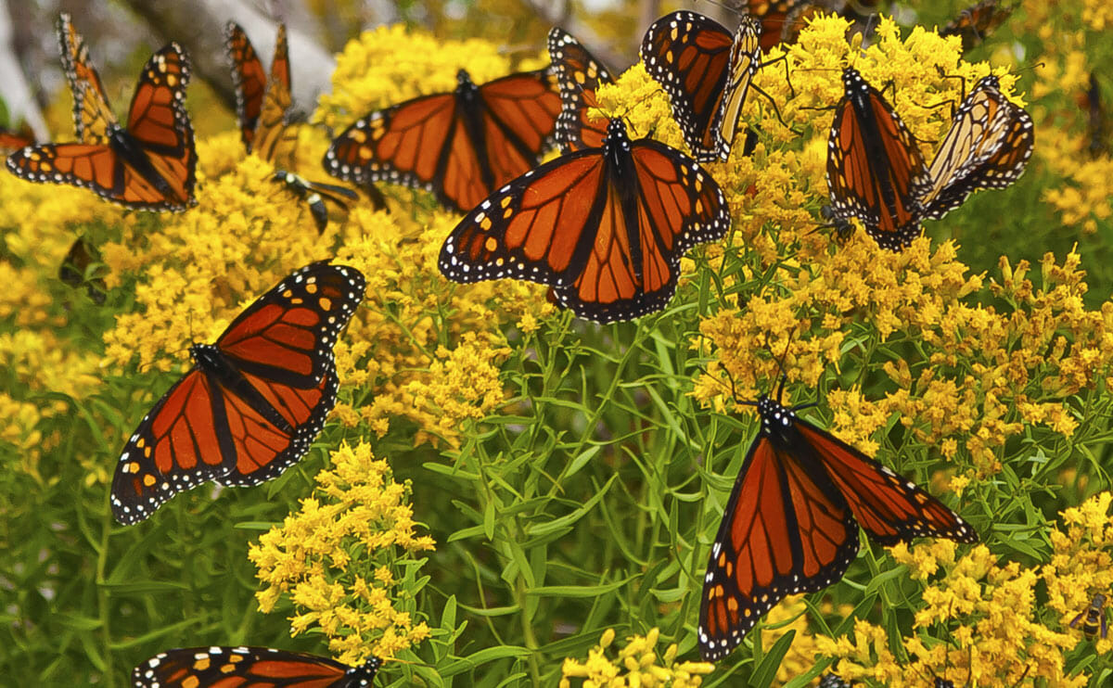
ACTION ITEMS

Slide 5
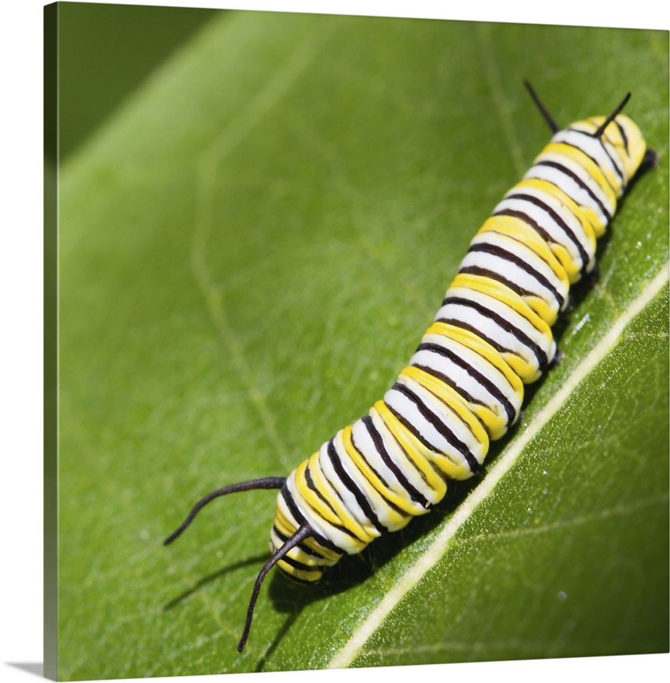
Communications & Convening:
Issue a Proclamation to raise awareness about the decline of the monarch butterfly and the species’ need for habitat.
Launch or maintain a public communication effort to encourage residents to plant monarch gardens at their homes or in their neighborhoods.
Engage with community garden groups and urge them to plant native milkweeds and nectar-producing plants.
Engage with city parks and recreation, public works, sustainability, and other relevant staff to identify opportunities to revise and maintain mowing programs and milkweed / native nectar plant planting programs.
Engage with gardening leaders and partners (e.g., Master Naturalists, Master Gardeners, Nature Centers, Native Plant Society Chapters, other long-standing and influential community leaders) to support monarch butterfly conservation.
Engage with Homeowners Associations (HOAs), Community Associations or neighborhood organizations to identify opportunities to plant monarch gardens and revise maintenance and mowing programs.
Engage with developers, planners, landscape architects, and other community leaders and organizers engaged in planning process to identify opportunities to create monarch habitat.
Create a community-driven educational conservation strategy that focuses on and benefits local, underserved residents.
Create a community art project to enhance and promote monarch and pollinator conservation as well as cultural awareness and recognition.

Slide 6
Program & Demonstration Gardens:
Host or support a native seed or plant sale, giveaway or swap.
Facilitate or support a milkweed seed collection and propagation effort.
Plant or maintain a monarch and pollinator-friendly demonstration garden at City Hall or another prominent or culturally significant community location.
Convert vacant lots to monarch habitat.
Plant milkweed and pollinator-friendly native nectar plants in medians and public rights-of-way.
Launch or maintain an outdoor education program(s) (e.g., at schools, after-school programs, community centers and groups) that builds awareness and creates habitat by engaging students, educators, and the community in planting native milkweed and pollinator-friendly native nectar plants (i.e., National Wildlife Federation’s Eco-Schools USA Schoolyard Habitats program and Monarch Mission curriculum).
Earn or maintain recognition for being a wildlife-friendly city by participating in other wildlife and habitat conservation efforts (i.e., National Wildlife Federation’s Community Wildlife Habitat program).
Host or support a monarch neighborhood challenge to engage neighborhoods and homeowners’ associations within the community to increase awareness, support community unity around a common mission, and/or create habitat for the monarch butterfly.
Initiate or support community science (or citizen science) efforts that help monitor monarch migration and health.
Add or maintain native milkweed and nectar producing plants in community gardens.
Launch, expand, or continue an invasive species removal program that will support the re-establishment of native habitats for monarch butterflies and other pollinators.
Host or support a monarch butterfly festival that is accessible to all residents in the community and promotes monarch and pollinator conservation, as well as cultural awareness and recognition.
Display educational signage at monarch gardens and pollinator habitat.

Slide 7
Systems Change:
Remove milkweed from the list of noxious plants in city weed / landscaping ordinances (if applicable).
Change weed or mowing ordinances to allow for native prairie and plant habitats.
Increase the percentage of native plants, shrubs and trees that must be used in city landscaping ordinances and encourage use of milkweed where appropriate.
Direct city property managers to consider the use of native milkweed and nectar plants at city properties where possible.
Integrate monarch butterfly conservation into the city’s Park Master Plan, Sustainability Plan, Climate Resiliency Plan or other city plans.
Change ordinances so herbicides, insecticides, or other chemicals used in the community are not harmful to pollinators.
Adopt ordinances that support reducing light pollution.

Slide 8
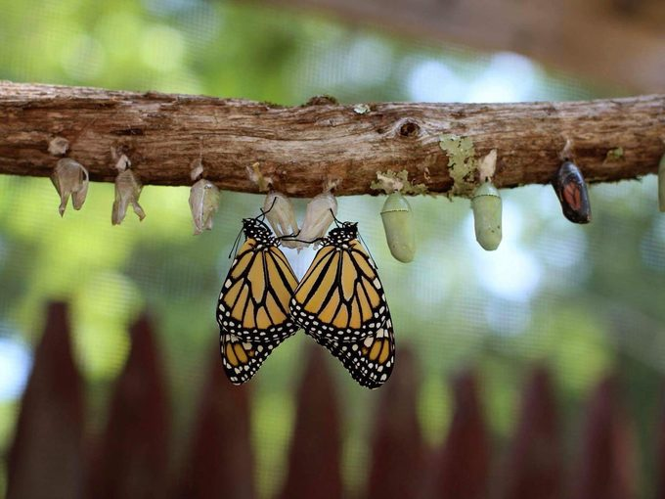
Where Do We Go From Here
Take the Pledge and Specify Your Actions
Mayor to sign pledge
Coordinate with EAC to develop action items
Take Action With Support From the National Wildlife Federation
Your community will gain access to online resources, monthly newsletters, webinars, and more, to help you complete your specified actions.
Report Progress
Track progress thru the year
Submit Annual Report by December 1

Slide 9
QUESTIONS For More Information on the Pledge http://nwf.org/MayorsMonarchPledge

